Slide 1
Conclusion to Windows Azure for Research Training!
Microsoft Research
Windows Azure for Research Training

Slide 2
Windows Azure for Research
Learning objectives – what you have learned from the class:
An understanding of cloud computing
Why and when you would use it in scientific or other research
Hands-on experience in major patterns for successful cloud applications
Skills to run your own applications/services on Windows Azure
Ultimately: researchers will feel confident in applying cloud computing in their current and future research

Slide 3
Next Steps
Use Windows Azure! Use your Training Pass for the next 180 days! https://manage.windowsazure.com/
Apply for a Research Award from Microsoft Research http://www.windowsazurepass.com/research (see next slide)
More information on Windows Azure for Research http://azure4research.com (more research-specific resources coming)
Join the community http://www.windowsazure.com/en-us/support/forums/ (research and non-research)
Other resources, including full documentation, curriculum materials, etc. http://www.windowsazure.com

Slide 4
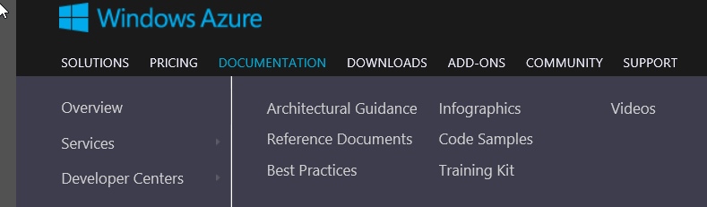
Next Steps (Continued)
Windows Azure Training Kit For developers!
http://www.windowsazure.com/en-us/develop/net/other-resources/training-kit/
More on Architecture, Reference, Best Practice, Code samples on WindowsAzure.com Developer Center.

Slide 5
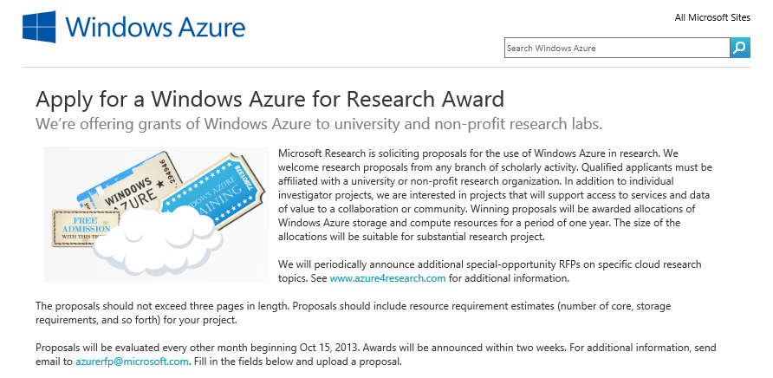
Windows Azure Research Awards
2-month recurring RFP
3-page max proposal
Compelling research
State Azure needs
Training helps!
Awards: 1 year Research Pass (worth up to $40,000)
http://www.windowsazurepass.com/research

Slide 6
More training
For you, your colleagues, your students, your contacts…
Academic Research http://research.microsoft.com/en-us/projects/azure/training.aspx
Academic Teaching http://www.microsoft.com/education/facultyconnection/WinAzure.aspx http://www.windowsazure.com/en-us/community/education/
Everyone - Microsoft Developer Camps http://www.microsoft.com/enterprise/events/make-it-happen

Slide 7



Windows Azure for Research
Accelerate the Speed of Scientific Discovery
Windows Azure provides researchers with the power and scalability of cloud computing for collaboration, computation, and data-intensive processing. This open and flexible global cloud platform supports any language, tool, or framework.
The Windows Azure for Research program:
· Free access to Windows Azure cloud computing and storage
(submit proposals for Windows Azure Research Awards)
· Windows Azure for Research training classes
· Support and technical resources
Apply the power of cloud computing to your computational and data challenges. Experiment at azure4research.com.
Notes:
What MSR is doing

Slide 8
http://azure4research.com
Microsoft Research
Windows Azure for Research
Notes:
By default, send people here – URL for the previous slide

Slide 9
Course evaluation survey

Slide 10
Any final questions? azuretraining@microsoft.com

Slide 11
Goodbye! Have a safe trip home!
Microsoft Research
Windows Azure for Research Training

Slide 12
© 2013 Microsoft Corporation. All rights reserved. Microsoft, Windows, Windows Vista and other product names are or may be registered trademarks and/or trademarks in the U.S. and/or other countries.
The information herein is for informational purposes only and represents the current view of Microsoft Corporation as of the date of this presentation. Because Microsoft must respond to changing market conditions, it should not be interpreted to be a commitment on the part of Microsoft, and Microsoft cannot guarantee the accuracy of any information provided after the date of this presentation. MICROSOFT MAKES NO WARRANTIES, EXPRESS, IMPLIED OR STATUTORY, AS TO THE INFORMATION IN THIS PRESENTATION.

